Slide 1
IMDP PROTOCOL
Group Members:
M.Abdullah (Team Leader)
Ameer Hamza
M.Adeel

Slide 2
Challenge Theme:
Revolutionize Social Services.

Slide 3
Problem Statement?
Increasing number of accidents due to driver fatigue.

Slide 4
Potential Solution:
Install a device called IMDP Protocol based on Image Processing and Sensor Analytics.
Device will include
1)Webcam
2)Sensors
Webcam will installed on the front of the driver watching its activities.
Sensors will be installed on the backside of driver pressing against the front side of driver’s seat.

Slide 5
Tools & Technology Used:
The software requirements include:
C#.net
Azure Cloud database
Arduino IDE
Azure Cognitive Service
The hardware requirements for this application to work is:
Arduino UNO
Breadboard
Sensors
Jumper wires or any connecting wires
2 Webcams

Slide 6
Benefits:
Reducing Car accident rate due to Driver fatigue about 75%
Prevention of loss of life
Prevention of property damage
Prevention of permanent disability
Saves Money

Slide 7
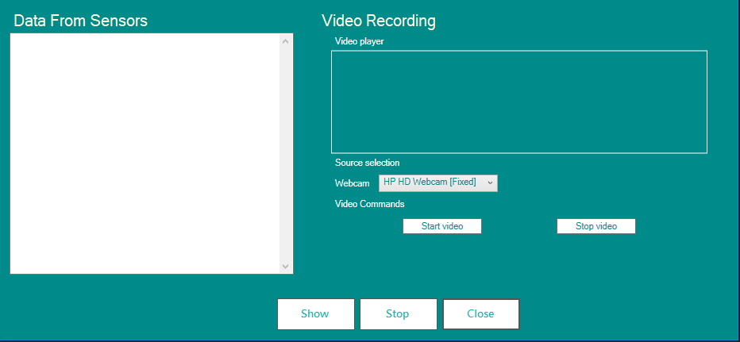
Screenshots:

Slide 8
ANY QUESTIONS?

